Slide 1

SpaceX Falcon 9 First Stage Landing Prediction
GitHub Repository:
https://github.com/Satish-KumarRam/IBM-Data-Science-Capstone-Project
IBM Data Science Professional Certificate Capstone Project
Satish Kumar Ram
01 August 2026

Slide 2



OUTLINE
Executive Summary
Introduction
Methodology
Results
Conclusion
Appendix
GitHub Repository:
https://github.com/Satish-KumarRam/IBM-Data-Science-Capstone-Project

Slide 3

EXECUTIVE SUMMARY
Objective
Predict Falcon 9 first-stage landing success using historical launch data.
Methodology Summary
Data Collection through SpaceX REST API
Data Collection with Web Scraping (Wikipedia)
Data Wrangling
Exploratory Data Analysis (Visualization & SQL)
Interactive Visual Analytics (Folium & Plotly Dash)
Predictive Analysis using Machine Learning
Key Results
Landing success increased over time.
Payload mass, orbit, and launch site significantly affected landing success.
The best machine learning model achieved the highest prediction accuracy.
GitHub Repository:
https://github.com/Satish-KumarRam/IBM-Data-Science-Capstone-Project

Slide 4

INTRODUCTION
Project Background: SpaceX reduces launch costs by successfully recovering and reusing Falcon 9 first-stage boosters, making launches more efficient and cost-effective.
Problem Statement: Predict whether the Falcon 9 first-stage landing will be successful before launch using historical mission data and machine learning techniques.
Project Objective: Build, train, and evaluate machine learning classification models to predict Falcon 9 first-stage landing success using historical launch data.
Data Sources:
SpaceX REST API: Launch information, payload details, booster version, launch site, and mission outcomes.
Wikipedia (Web Scraping): Additional Falcon 9 launch records used to validate and enrich the dataset.

Slide 5

METHODOLOGY
Data Collection:
Collected Falcon 9 launch data using the SpaceX REST API.
Collected additional launch records through Wikipedia Web Scraping.
Data Wrangling:
Cleaned missing values and standardized the dataset.
Merged API and Wikipedia datasets.
Exploratory Data Analysis (EDA):
Created visualizations using Matplotlib and Seaborn.
Analyzed relationships between mission features and landing success.
SQL Analysis:
Queried the database to analyze launch statistics.
Retrieved insights using SQL queries.
Interactive Visualization:
Built interactive Folium maps.
Developed a Plotly Dash dashboard.
Predictive Analysis:
Built and evaluated multiple classification models.
Selected the best-performing model.

Slide 6
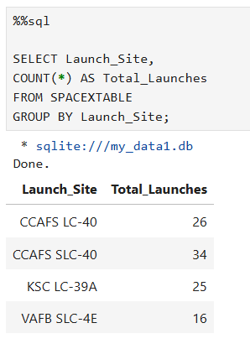
EDA Using SQL Queries (Part 1)
SQL Query Output – Launch Site Analysis
Key Findings:
Used SQL to calculate total launches for each Falcon 9 launch site.
CCAFS SLC-40 recorded the highest number of launches (34).
CCAFS LC-40 completed 26 launches during the analyzed period.
KSC LC-39A completed 25 launches.
VAFB SLC-4E recorded the fewest launches (16).
These SQL results identified the busiest launch sites and supported subsequent visualization and predictive analysis.

Slide 7
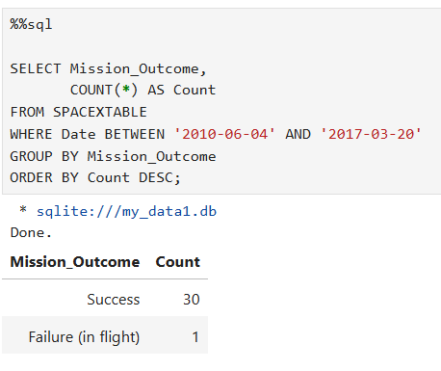
EDA Using SQL Queries (Part 2)
Mission Outcome Analysis (SQL Query Result)
Key Findings:
SQL was used to summarize mission outcomes.
30 missions were completed successfully.
Only 1 mission resulted in failure during the selected period.
The high success rate indicates improved Falcon 9 reliability.
SQL aggregation helped validate mission performance before predictive modeling.

Slide 8
Results
Landing Success Trend: Landing success improved steadily over time.
Key Factors: Payload mass, launch site, orbit type, flight number, and booster version influenced landing success.
EDA, SQL & Visualization: SQL queries, Folium maps, and the Plotly Dash dashboard provided interactive insights.
Predictive Analysis: The best classification model achieved the highest prediction accuracy.
Overall Outcome: Historical launch data can effectively predict Falcon 9 first-stage landing success and support mission planning.
GitHub Repository:
https://github.com/Satish-KumarRam/IBM-Data-Science-Capstone-Project

Slide 9
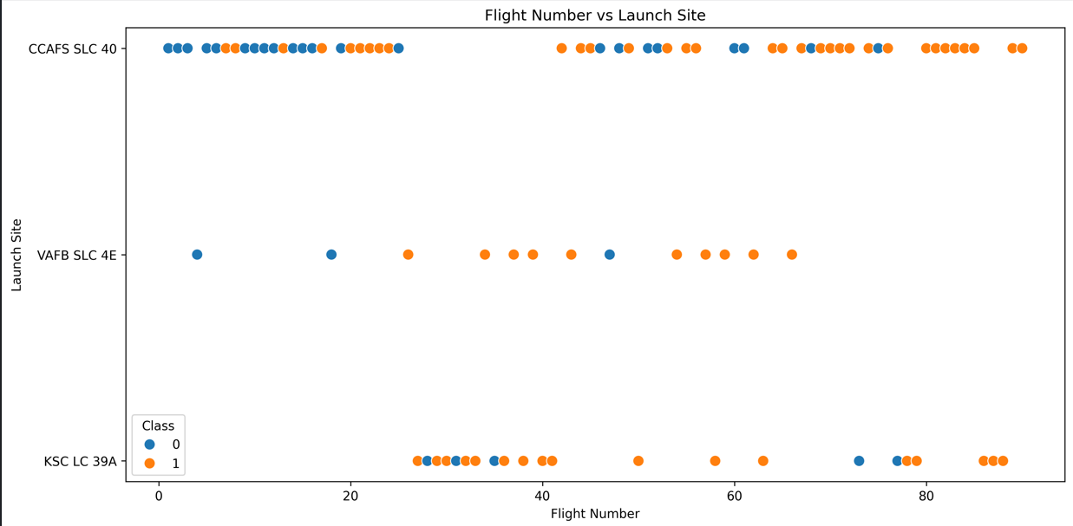
Flight Number vs. Launch Site
Key Findings
Early Falcon 9 missions had lower landing success, while later missions showed higher success rates.
Launch success improved as the flight number increased, indicating continuous improvements in booster recovery and operational experience.
CCAFS SLC 40 recorded the highest number of Falcon 9 launches, making it the most frequently used launch site.
KSC LC 39A and VAFB SLC 4E also demonstrated successful landings, although with fewer launches than CCAFS SLC 40.
Overall, both launch site and flight number influenced Falcon 9 first-stage landing success.

Slide 10
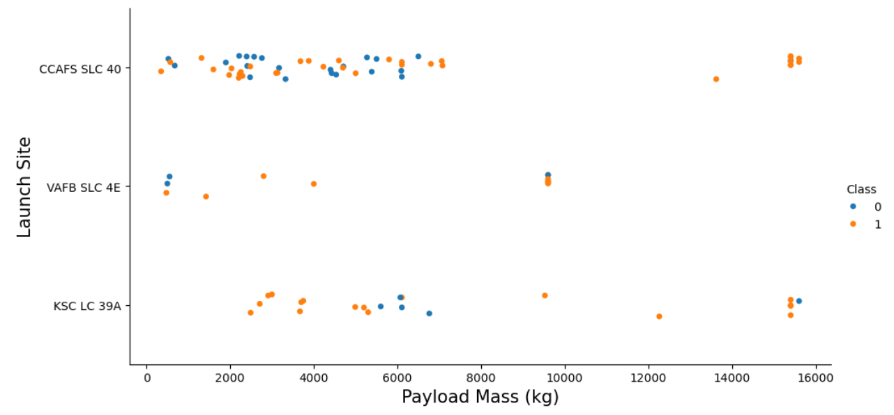
Payload Mass vs. Launch Site
Key Findings
CCAFS SLC 40 handled the widest range of payload masses and was the most frequently used launch site.
KSC LC 39A primarily handled medium- to high-payload missions and achieved several successful landings.
VAFB SLC 4E conducted fewer launches but demonstrated successful missions across different payload categories.
Both successful and unsuccessful landings occurred at low, medium, and high payload masses, indicating that payload mass alone was not the primary factor affecting landing success.
Overall, launch site and payload mass together influenced Falcon 9 landing success.

Slide 11
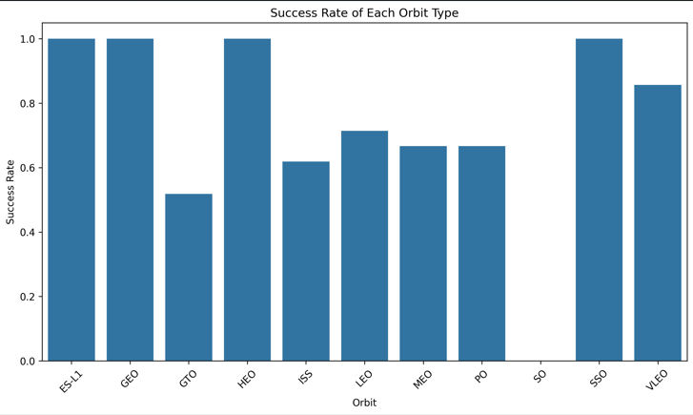
Success Rate by Orbit
Key Findings
ES-L1, GEO, HEO, and SSO achieved a 100% landing success rate, indicating highly reliable mission outcomes for these orbit types.
VLEO also demonstrated a high landing success rate of approximately 86%, showing strong booster recovery performance.
LEO, MEO, ISS, and PO achieved moderate landing success rates, indicating variable mission outcomes across these orbit types.
GTO recorded a comparatively lower landing success rate, while SO showed no successful landings in the available dataset.
Overall, orbit type significantly influenced Falcon 9 landing success, although mission characteristics and operational factors also played important roles.

Slide 12
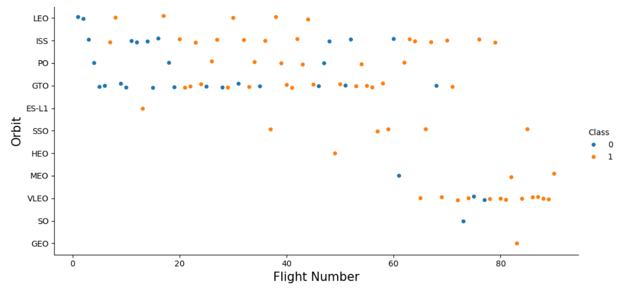
Flight Number vs. Orbit
Key Findings
LEO, ISS, and VLEO missions generally achieved high landing success rates.
GTO missions showed mixed landing outcomes, with both successful and failed landings.
Landing success generally improved with increasing flight numbers, especially in later missions.
Orbit type influenced landing success, while payload mass and launch site also played important roles.

Slide 13
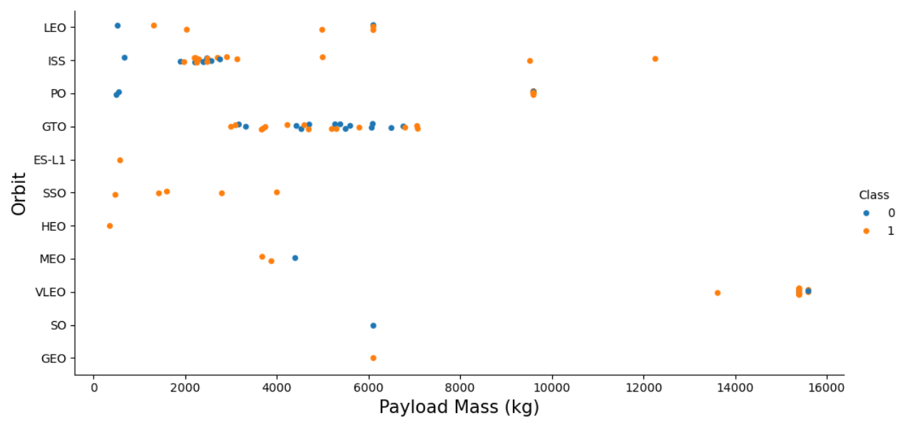
Payload Mass vs. Orbit
Key Findings
GTO missions covered a wide range of payload masses, with both successful and unsuccessful landings observed.
VLEO missions were associated with the highest payload masses.
LEO and ISS missions generally carried low to medium payload masses.
Payload mass alone did not determine Falcon 9 landing success; orbit type and mission characteristics also influenced landing outcomes.

Slide 14
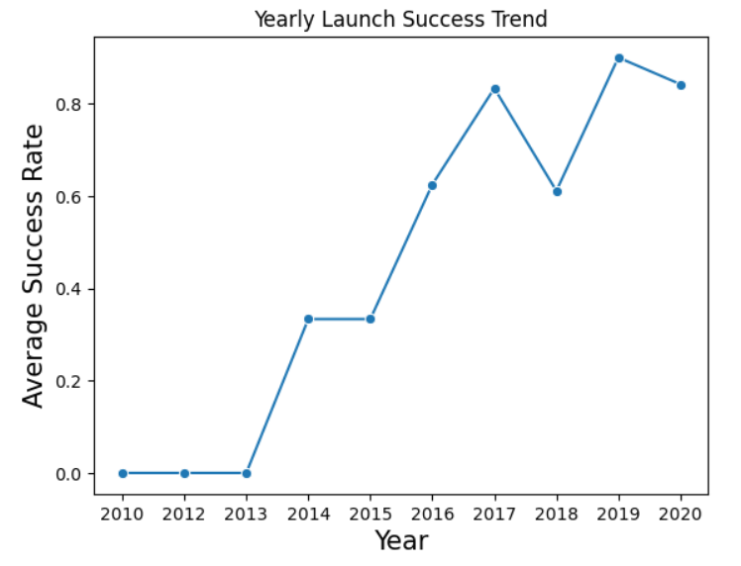
Yearly Launch Success Trend
Key Findings
Overall launch success rates improved over the years despite minor fluctuations.
Success rates were very low during the early years (2010–2013).
From 2016 onward, average launch success rates increased significantly.
By 2019–2020, SpaceX consistently achieved high launch success rates, demonstrating improved booster recovery and mission reliability.

Slide 15
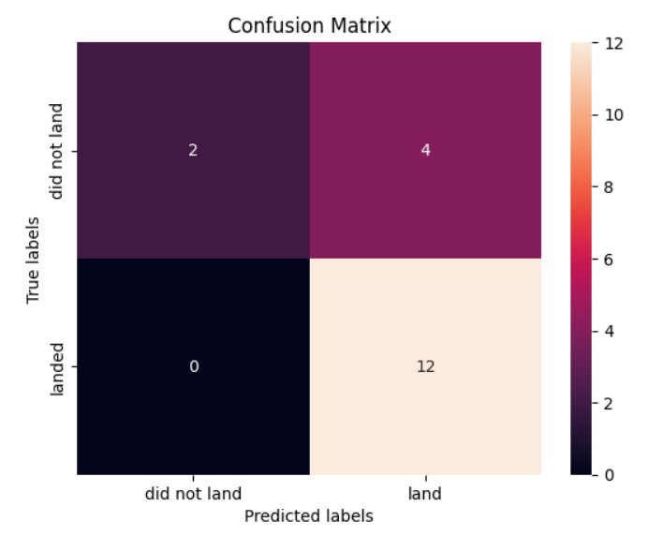
Model Evaluation – Confusion Matrix
Key Findings
The model correctly predicted 12 successful landings (True Positives).
2 unsuccessful landings were correctly classified (True Negatives).
4 unsuccessful landings were incorrectly predicted as successful (False Positives).
The model demonstrated strong performance in identifying successful landings, with no false negatives, although some unsuccessful missions were incorrectly classified as successful.

Slide 16
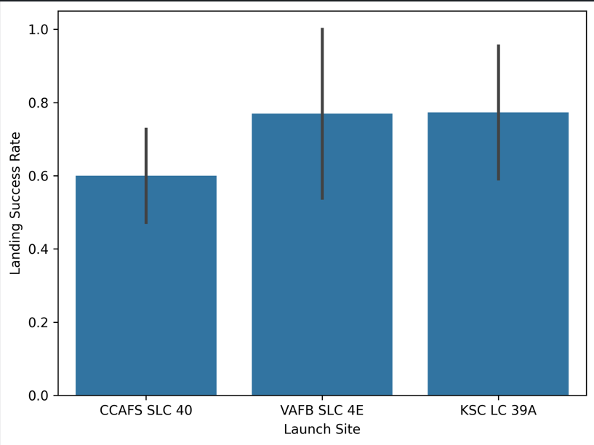
Landing Success by Launch Site
Key Findings
KSC LC 39A achieved the highest average landing success rate among all launch sites.
VAFB SLC 4E also recorded a high landing success rate, indicating strong mission performance.
CCAFS SLC 40 showed the lowest average landing success rate in the dataset.
Launch site significantly influenced Falcon 9 first-stage landing success.
GitHub Repository:
https://github.com/Satish-KumarRam/IBM-Data-Science-Capstone-Project

Slide 17
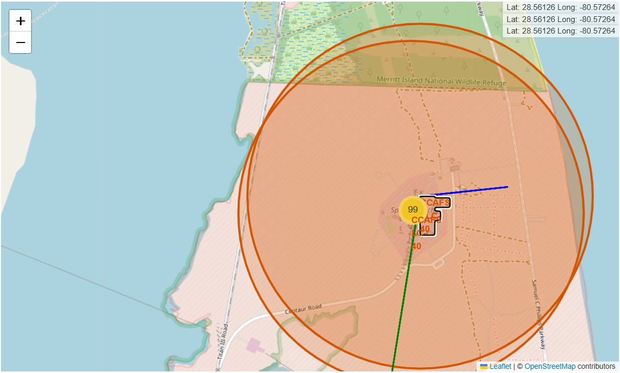
Launch Site Proximity Analysis (CCAFS)
Key Findings:
CCAFS launch site is located close to the coastline.
The coastal location supports safe launch trajectories over the ocean.
The site is positioned away from major populated areas to improve safety.
The proximity map highlights CCAFS's strategic coastal location for safe launch operations.

Slide 18
SPACEX FALCON 9 – FINDINGS & IMPLICATIONS
Findings
Launch success rate improved over time.
Launch site, payload mass, flight number, and orbit type significantly influenced landing success.
The best-performing classification model demonstrated strong predictive performance.
Implications
Machine learning can effectively predict Falcon 9 landing success.
The predictive model can support mission planning and reduce launch costs.
Data-driven insights help improve future SpaceX launch decisions.

Slide 19
Results – Visualizations & Dashboard
EDA Visualizations
Interactive Dashboard
Flight Number vs. Launch Site
Payload Mass vs. Launch Site
Success Rate by Orbit
Flight Number vs. Orbit
Payload Mass vs. Orbit
Yearly Launch Success Trend
Landing Success by Launch Site
SQL Query Results
Folium Launch Site Map
Plotly Dash Dashboard
Confusion Matrix (Model Evaluation)
GitHub Repository:
https://github.com/Satish-KumarRam/IBM-Data-Science-Capstone-Project

Slide 20
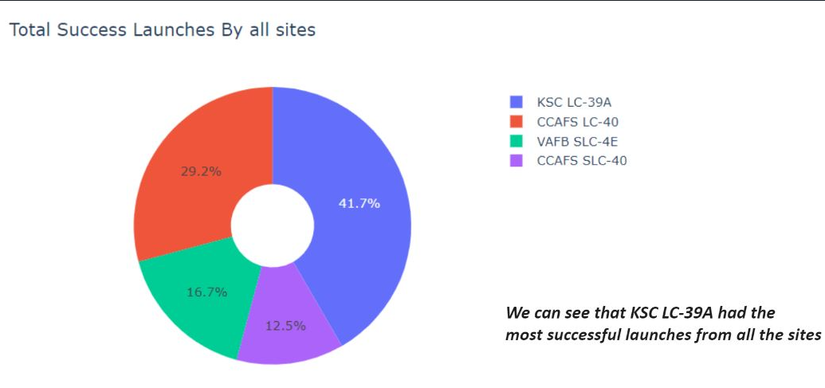
Interactive Dashboard (Plotly Dash)
Total Success Launches by All Sites (Pie Chart)
Key Findings:
Interactive dashboard developed using Plotly Dash.
Displays successful launches across all launch sites.
KSC LC-39A recorded the highest number of successful launches.
GitHub Repository:
https://github.com/Satish-KumarRam/IBM-Data-Science-Capstone-Project

Slide 21
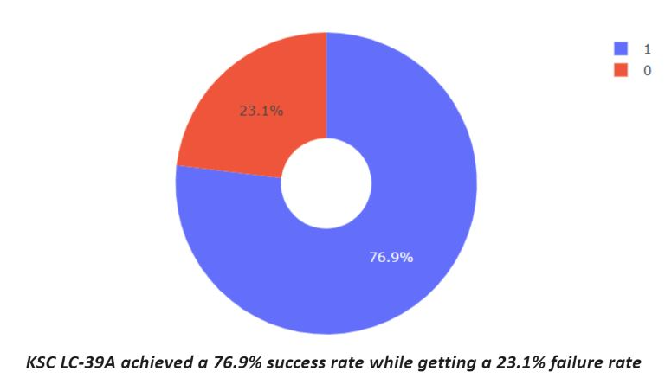
Launch Site Analysis
KSC LC-39A: Success vs Failure
Key Findings:
Payload mass is compared with launch success.
Different colors represent booster versions.
The dashboard allows interactive payload range filtering.
The visualization helps identify payload-related launch patterns.
GitHub Repository:
https://github.com/Satish-KumarRam/IBM-Data-Science-Capstone-Project

Slide 22
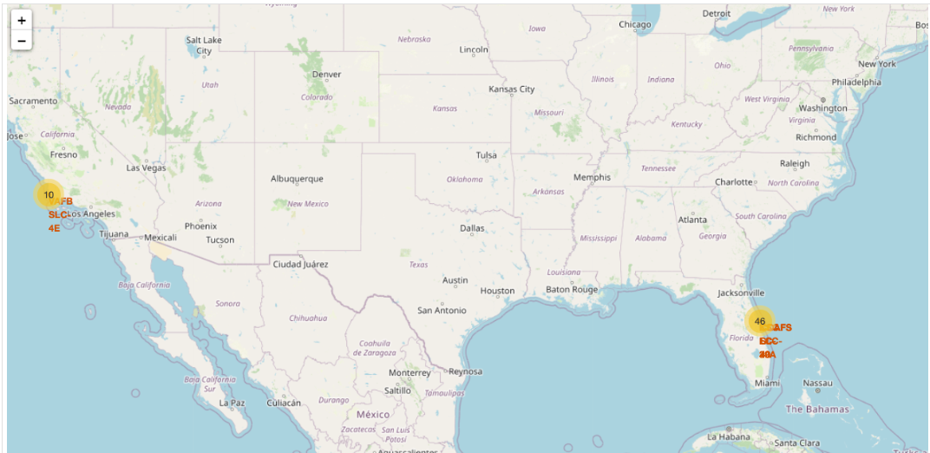
Interactive Launch Site Map (Folium)
Launch Site Distribution (Folium)
Key Findings:
Visualized Falcon 9 launch sites using Folium.
Interactive markers display launch site locations and launch counts.
CCAFS SLC-40 recorded the highest number of Falcon 9 launches, indicating it was the most active launch site.
Geographic analysis helped compare launch site distribution.
Location-based visualization helped identify launch site patterns and supported predictive analysis.

Slide 23
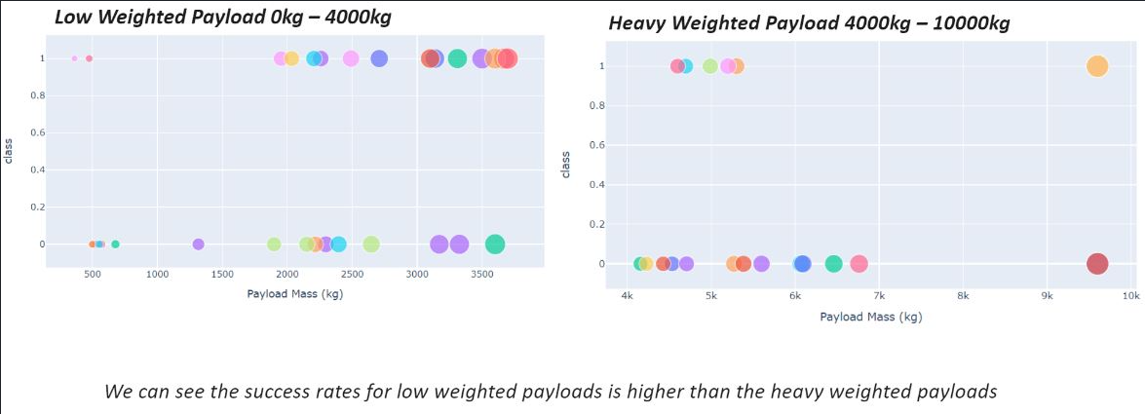
Payload Analysis
Payload vs Launch Success
Key Findings:
Shows the relationship between payload mass and launch success.
Interactive payload range slider enables dynamic filtering.
Different booster versions are represented by different colors.
GitHub Repository:
https://github.com/Satish-KumarRam/IBM-Data-Science-Capstone-Project

Slide 24
Conclusion
Key Takeaways
The analysis identified several factors that influence SpaceX Falcon 9 landing success.
Flight Number showed a positive relationship with landing success, indicating improved performance over time.
Payload mass, orbit type, and launch site were key factors influencing landing success.
Overall Findings
Landing success rates improved significantly over time, reaching their highest levels by 2019 and remaining consistently high thereafter.
Historical launch data provides valuable insights into Falcon 9 landing success and supports data-driven decision-making.

Slide 25

GITHUB REPOSITORY
GitHub Repository
https://github.com/Satish-KumarRam/IBM-Data-Science-Capstone-Project

Slide 26

APPENDIX
Additional Analysis
SQL query outputs used for exploratory analysis.
Interactive Plotly Dash dashboard for exploratory data analysis.
Folium map showing launch site proximity.
Additional EDA charts supporting model development.
GitHub Repository:
https://github.com/Satish-KumarRam/IBM-Data-Science-Capstone-Project

Slide 27
Thank You!
IBM Data Science Professional Certificate
Capstone Project

